Slide 1
Digital Accessibility
The new regulations and what they mean for teaching

Slide 2

New Legislation
The EU Directive on the accessibility of public sector websites and mobile applications.
The Public Sector Bodies (Websites and Mobile Applications) Accessibility Regulations (2018).
Accessible VLEs – the ‘Policy Connect’ Briefing (The easy read).
Notes:
An extension to the existing Equality Act 2010 the aim of which is to protect individuals from unfair treatment and promotes a fair and more equal society.

Slide 3
What’s in scope?
Websites and intranets (Both the platform, and the content)
Documents on websites and intranets
Videos and multimedia content
Libraries
Student portals
Staff systems
Apps
Purchased third party content and tools

Slide 4
Timescales
Public-facing websites
New or updated online content published on or after 23 Sept 2018 has to comply by 22 Sept 2019.
Existing sites (published before 23 Sept 2018) must comply by Sept 2020.
Intranets (behind a password) incl. Moodle
New or substantially revised content published on or after 23 Sept 2019 to comply with the requirements of the regulations on publication.
Intranet content published before 23 September 2019, doesn’t have to be brought into compliance at a fixed point; they must instead be brought into compliance only when first substantially revised on or after 23 September 2019

Slide 5
Exemptions
Recorded media (live video, skype, Lecturecast) published before 23 Sept 2020
Live audio and video
Third party content that UCL didn’t pay for or develop (e.g. external social media content)
Heritage collections – e.g. scanned manuscripts
Online maps
Archived websites if they are not needed for services we provide

Slide 6

Disproportionate burden
To declare that making particular things accessible is a disproportionate burden, we must weigh up:
the burden that making those things accessible places on UCL
the benefits of making those things accessible
We need to think about:
UCL’s size and resources
how much making things accessible would cost and the impact that would have on UCL
how much users with a disability would benefit from us making things accessible

Slide 7

Monitoring & enforcement
Government Digital Services (GDS) will monitor and report
Equalities and Human Rights Commission (EHRC) is the enforcement body
Both will aim to provide a proportionate, corrective and supportive mechanism for compliance – they don’t want us closing down sites
Sample of 2055 sites initially

Slide 8
Grey areas
There are quite a few, not least
  how much needs to be done to improve accessibility of individual files in Moodle;
  what level of video captioning is needed;
  what constitutes a disproportionate burden.

Slide 9
Work done to date
Samples of website, Moodle, online library (Jisc snapshots)
New online guidance created
Awareness-raising in the academic community
Liaison with Jisc, GDS, Ucisa, across the sector
Established a Task and Finish group

Slide 10
What can we all do?

Slide 11
For Moodle, use the baseline…
Meaningful structure with:
  Section overviews.
  Group and label content.
Consistent navigation
Labelling
  Templates and consistency across courses.
Presentation
  Clear layouts
  Good spacing
  Text that isn’t cramped, or dense.

Slide 12
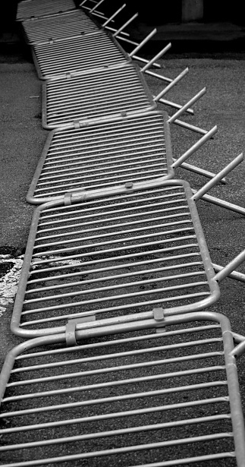
Common barriers
Barrier | Who is affected
Poorly structured and signposted web pages and Moodle courses. | Everyone.
Poorly structured and tagged documents. | Principally screen-reader and keyboard-only users, but everyone might find clear structure and navigation helpful
Poor colour contrast, or using colour as a sole method to communicate. | Visually impaired and dyslexic users.
Images without alternative descriptive text. | Screen-reader users.
Inaccessible PDFs (especially ones based on scanned images). | Screen-reader users and dyslexic user.
Media content without subtitles, captions or audio descriptions. | D/deaf, dyslexic users and non-native English.

Slide 13

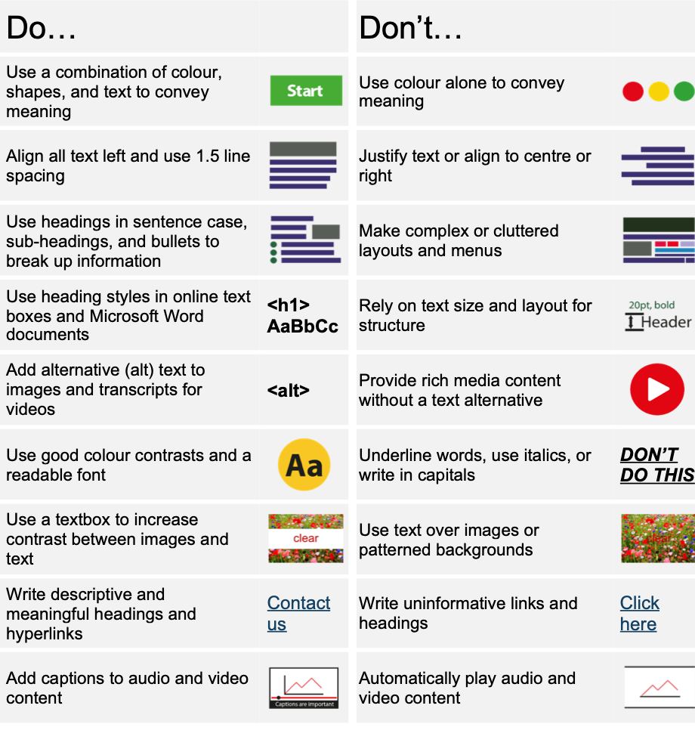
Other Dos and Don’ts
Do … | Don’t …
Use a combination of colour, shapes and text to convey meaning | Use colour alone to convey meaning
Align all text left and use 1.5 line spacing | Justify text or align to the centre or right
Use headings in sentence case, sub-headings and bullets to break-up information | Make complex or cluttered layouts and menus
Using heading styles in online text boxes and Microsoft Word documents | Rely on text size and layout for structure
Use alternative (alt) text for images and transcripts for videos | Provide rich media content without a text alternative
Use good colour contrast and a readable font | Underline words, use italics or write in capitals
Use a textbox to increase contrast between images and text | Use text over images or patterned backgrounds
Write descriptive and meaningful headings and hyperlinks | Write uninformative links and headings
Add captions to audio and video content | Automatically play audio and video content

Slide 14

What you can do now
Follow the Accessibility Fundamentals in your day-to-day work.
Check your Moodle course structure.
Check files before uploading to Moodle.
Don’t panic, and don’t throw the baby out with the bathwater…

Slide 15
Where to get help and advice
UCL guidance
  Briefings, Training Sessions and Drop-Ins
  Creating Accessible Content – online guidance
  Accessible Teaching Practices – self-paced Moodle course
  E-learning baseline – minimum expectations for Moodle course design
Government Digital Service
  Guidance on the legislation
  Nice set of “dos and don’ts” posters
Getting started with accessibility and inclusion – overview from Jisc

Slide 16
More info and help:
http://www.ucl.ac.uk/digital-accessibility
digitalaccessibility@ucl.ac.uk
M.farmer@ucl.ac.uk

